Slide 1
Computer assisted software engineering(CASE)
Presented by:
Sushrita Pyakurel

Slide 2
Table of contain
Introduction
CASE tool
Application development environment
Advantage of CASE
Limitation of CASE

Slide 3
Introduction :
The use of software tools to aid in the development , management , and maintenance of the software systems.
Automates repetitive and time consuming tasks .
Used to manage the entire software development process .
Used to support software development methodologies.
Used by both individuals and team
Can be customized to suit specific needs and workflow.
Helps to reduce costs and improve the overall quality of software system.

Slide 4
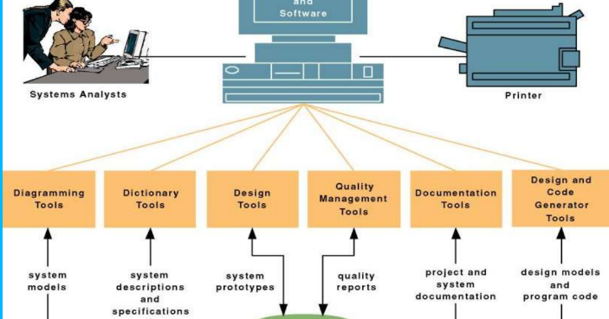
CASE tool architecture
Notes:
Case repository a system developers database where developers can store system models, detailed description.

Slide 5
CASE Tools:
Requirements management
Design and modeling
Construction and testing
Project management and configuration management

Slide 6

Requirements management tool:
Helps to manage and track requirements throughout the development process.
Analyzing and defining functional and non functional requirements.

Slide 7
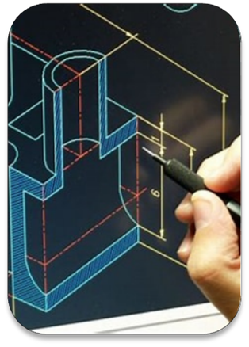
Design and modeling tool:
Helps to create visual models of the software.
Helps in defining and communicating
Used to create mockups and prototypes.

Slide 8

Construction and testing tool:
Helps to automate the process of writing and testing code.
Helps in making the software more efficient
Helps to ensure that product is of high quality.

Slide 9

Project management tool:
Helps to manage and trace the progress of the project.
Helps to ensure project is complete within time
Facilitate collaboration and communication

Slide 10
Application development environment(ADE):
Tools and resources that developer use to create ,test, and deploy software application.
Supports multiple language and platform.
Provided as a service known as integrated development environment(IDE).
Example : eclipse ,visual studio, xcode , and android studio.

Slide 11

Advantages of CASE:
Improving efficiency
Improving quality
Reducing errors
Improving maintainability
Enabling resuablity

Slide 12

Limitation of CASE:
Complexity
Cost
Dependency
Limited customization
Limited protablity

Slide 13

Any question????

